Slide 1
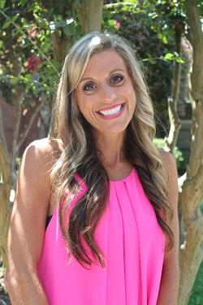
Mrs. Pate
I am overjoyed to welcome you to our 2nd grade family!
I look forward to building a classroom full of curious and courageous campers this year!! We will work hard and have fun!! I look forward to growing and glowing our best together!!
Welcome to
The Pate Pals!
Love,
Mrs. Pate
Editable
Add image directions on Teacher Note Page
Contact Information
Email: dpate@auburnschools.org
Phone: 334-887-4900
Favorites
Book: The Tale of Despereaux
Subject: Reading
Sport: Auburn Football
Drink: Coffee, La Croix
Food: Sushi
Place: Lake Martin
Movie: Wonder
DRES Tradition:
Rocket Run
Meet the Teacher
Friday, August 6 12p-2p
Room 56
1st Day of 2nd Grade
Tuesday, August 10
Students may enter at 7:10am

